Slide 1
“Introduction to statistics”
Course report
Author: Norkin Mark

Slide 2
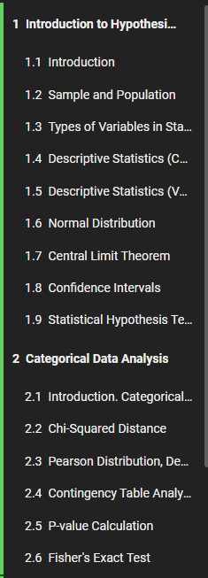
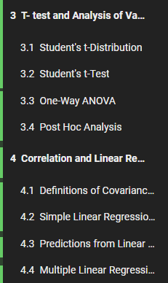
Introduction
Course program:
Introduction to Hypothesis Testing
Categorical Data Analysis
T- test and Analysis of Variance
Correlation and Linear Regression

Slide 3


First module
Introduction to Hypothesis Testing
Non-representative sample
Representative sample

Slide 4
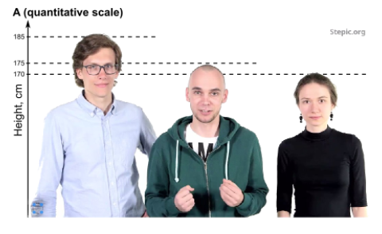
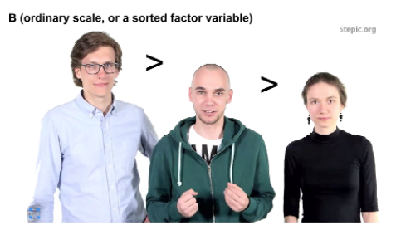
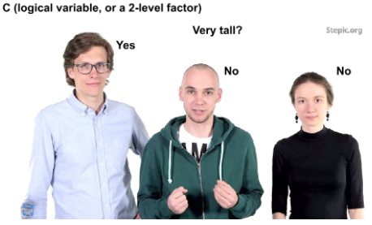
Second module
Categorical Data Analysis

Slide 5
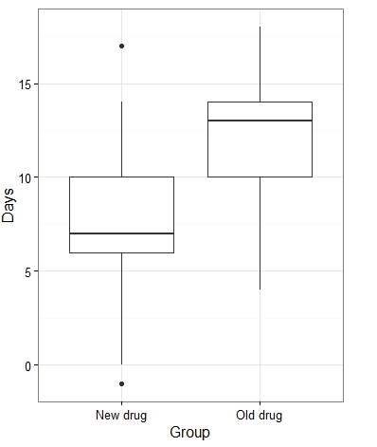
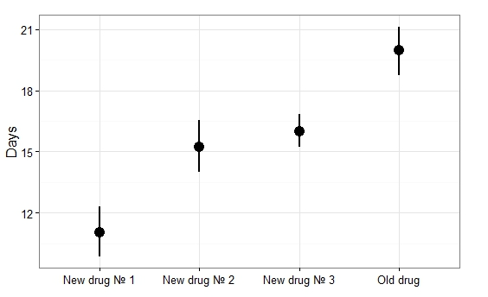
Third module
T- test and Analysis of Variance

Slide 6
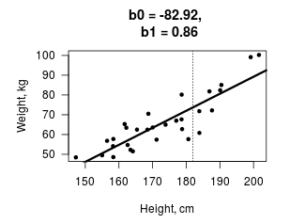
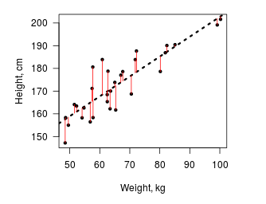
Fourth module
Correlation and Linear Regression

Slide 7
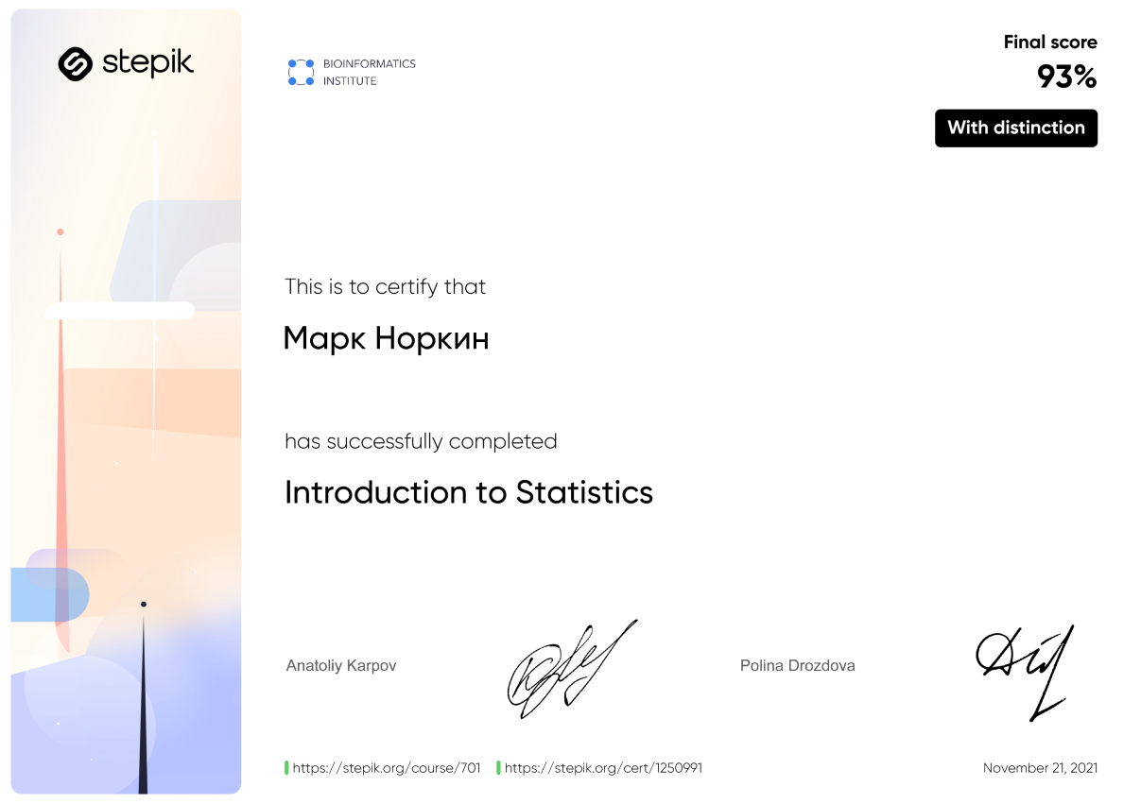
Results
Thank you for your attention!

